Slide 1
Embedded Students

Slide 2
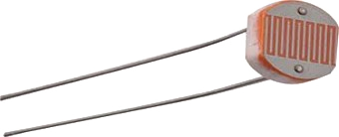
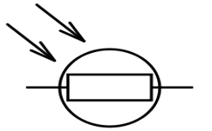
Analog components
LDR
Light Dependent Resistor
like a potmeter but changes according to amount of light.

Slide 3
Explain LDR
The resistance of an LDR changes depending on how much light falls onto it.
analogRead() will return a different value depending on light intensity.
More light → less resistance → higher value returned.

Slide 4
LDR usage
const int LDR_IN = 14;
const int LIGHT_THRESHOLD = 82;
int brightness = analogRead(LDR_IN);
if (brightness > LIGHT_THRESHOLD)
// too bright
else
// normal

Slide 5
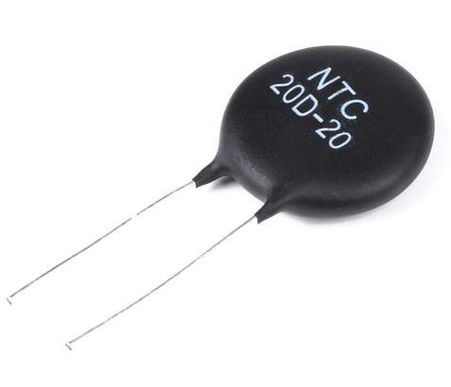

Analog Input
NTC
Negative Temperature Coefficient
Like a potmeter but changes according to temperature

Slide 6
NTC
The resistance of an NTC changes with temperature.
analogRead() will return a different value depending on light intensity.
More heat → lower resistance → higher value read

Slide 7
NTC usage
const int NTC_IN = 15;
const int TEMP_THRESHOLD = 149;
int temp = analogRead(NTC_IN);
if (temp > TEMP_THRESHOLD)
// too hot
else
// normal

Slide 8
Reading analog values
What if the read value is close to the threshold?
The real world isn’t discreet nor constant.
The read value will hover around the threshold

Slide 9
Threshold hovering solved
const int UPPER = 149;
const int LOWER = 125;
bool warning = false;
void loop() {
int temp = analogRead(NTC_IN);
if (!warning && temp > UPPER)
warning = true;
else if (warning && temp < LOWER)
warning = false;
// else don't change anything
}

Slide 10
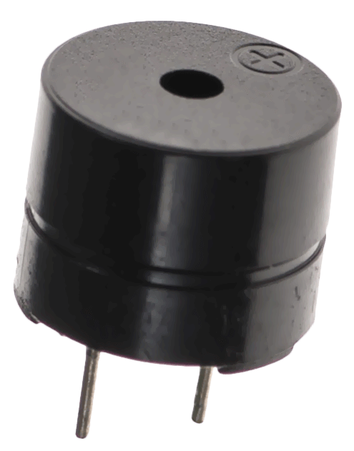
Buzzer

Slide 11

Digital
Buzzer
Piezo electric device
produces sound when a (fixed) waveform is applied.

Slide 12
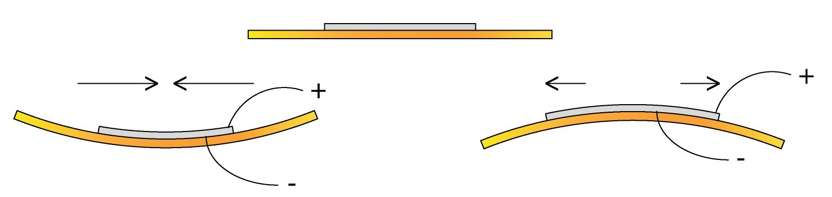
Piezo electric effect
A voltage is applied to a two layer membrane which contracts or expands.
Motion → air movement → sound!

Slide 13
Buzzer
If we quickly expand and contract we produce a sound wave.
Typical frequency: 440Hz (for an A)

Slide 14
Sound with Arduino
We could do this ourselves.
But is limited in range and precision.
Code is busy while playing (i.e. can’t do anything else while playing a tone)
digitalWrite(BUZZER, HIGH);
// @ 440hz period is 2.2ms
// 2.2 / 2 = 1ms
delay(1);
digitalWrite(BUZZER, LOW);
delay(1);

Slide 15
Sound with Arduino
The tone() function is specifically used for buzzers.
tone(pin, frequency, duration);
where
pin is the pin the buzzer is connected to
frequency is in Hz
duration is in ms

Slide 16
Code readability

Slide 17
Code readability
Better names improve code readability:
int button1_state;
/// ...
if (digitalRead(K1) == LOW)
button1_state = 1;
else
button1_state = 0
Should not use magic numbers:
button1_state = 1;
replace with:
const int PUSHED = 1;
/// ...
button1_state = PUSHED;

Slide 18
Enum type
We can improve this with an enum type:
enum button_state { PUSHED, RELEASED };
enum button_state button1 = RELEASED;
void loop()
{
}

Slide 19
Variables & Types
Creating a new type helps code readability:
Compare:
float temp_inside = 22.3;
float temp_outside = 15.8;
/* The range & unit is unknown*/
celsius temp_inside = 22.3;
celsius temp_outside = 15.8;
/* it is clear what the range & unit is */
Notes:
Explain left example we don’t know the range. because int = -32767 + 32767

Slide 20
New types
How to create a new type:
From here on celsius can be used.
typedef float celsius;
void setup()
{
}
void loop()
{
celsius inside_temp = 22.5;
}

